Slide 1





Agenda
INSURANCE ANALYSIS PROJECT
GROUP- 6 MEMBERS
Akash Chauhan
Manjeet Singh Ghuman
Pratik Dhobale
Rutik Gavand
INTRODUCTION
KPI AND INSIGHTS
EXCEL DASHBOARD
SQL QUERIES OUTPUT
TABLEAU DASHBOARD
POWERBI DASHBOARD
PROJECT CONCLUSIONS
RECOMMENDATIONS

Slide 2


Agenda
INTRODUCTION
KPI AND INSIGHTS
EXCEL DASHBOARD
SQL QUERIES OUTPUT
TABLEAU DASHBOARD
POWERBI DASHBOARD
RECOMMENDATIONS
CHALLENGES
CONCLUSIONS

Slide 3




INTRODUCTION
Objective: The primary goal of this project was to create a comprehensive dashboard to monitor and evaluate the weekly performance of branch activities within an insurance company.
The dashboard is designed to provide key insights into sales targets, achievements, and opportunities, allowing management to make data-driven decisions and improve overall operational efficiency.

Slide 4





KPI AND INSIGHTS
Performance Tracking by
Targets vs. Achievements:
Cross-Sell: Target of 20.08M with 11.79M achieved and 2.85M invoiced.
New Business: Target of 19.67M with 3.26M achieved and 0.57M invoiced.
Renewal: Target of 12.32M with 18.43M achieved and 8.24M invoiced.
KPI Metrics:
Cross-Sell Placement Achievement: 58.71%
Cross-Sell Invoice Achievement: 14.21%
New Placement Achievement: 16.57%
New Invoice Achievement: 2.90%
Renewal Placement Achievement: 149.62%
Renewal Invoice Achievement: 66.92%

Slide 5
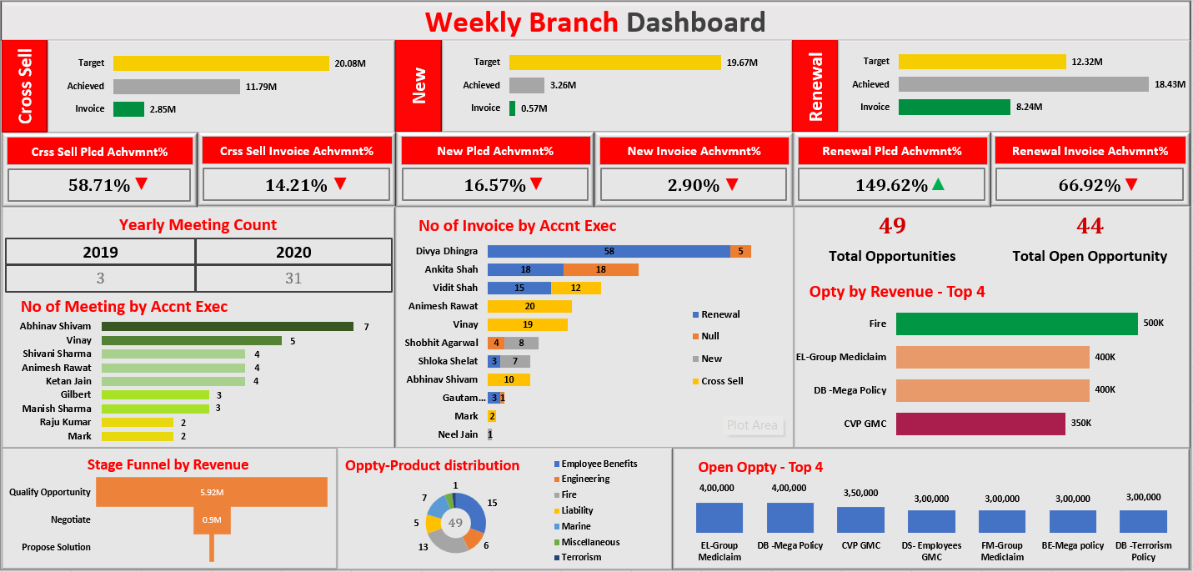
Excel Dashboard
KPI AND INSIGHTS
Opportunity Management:
Total Opportunities: 49
Open Opportunities: 44
Opportunity Distribution by Revenue:
Highlighting the top 4 opportunities by revenue, with 'Fire' leading at 500K.
Yearly Meeting Count:
Comparative analysis of the number of meetings held in 2019 (3) versus 2020 (31), indicating a significant increase in client engagement.

Slide 6
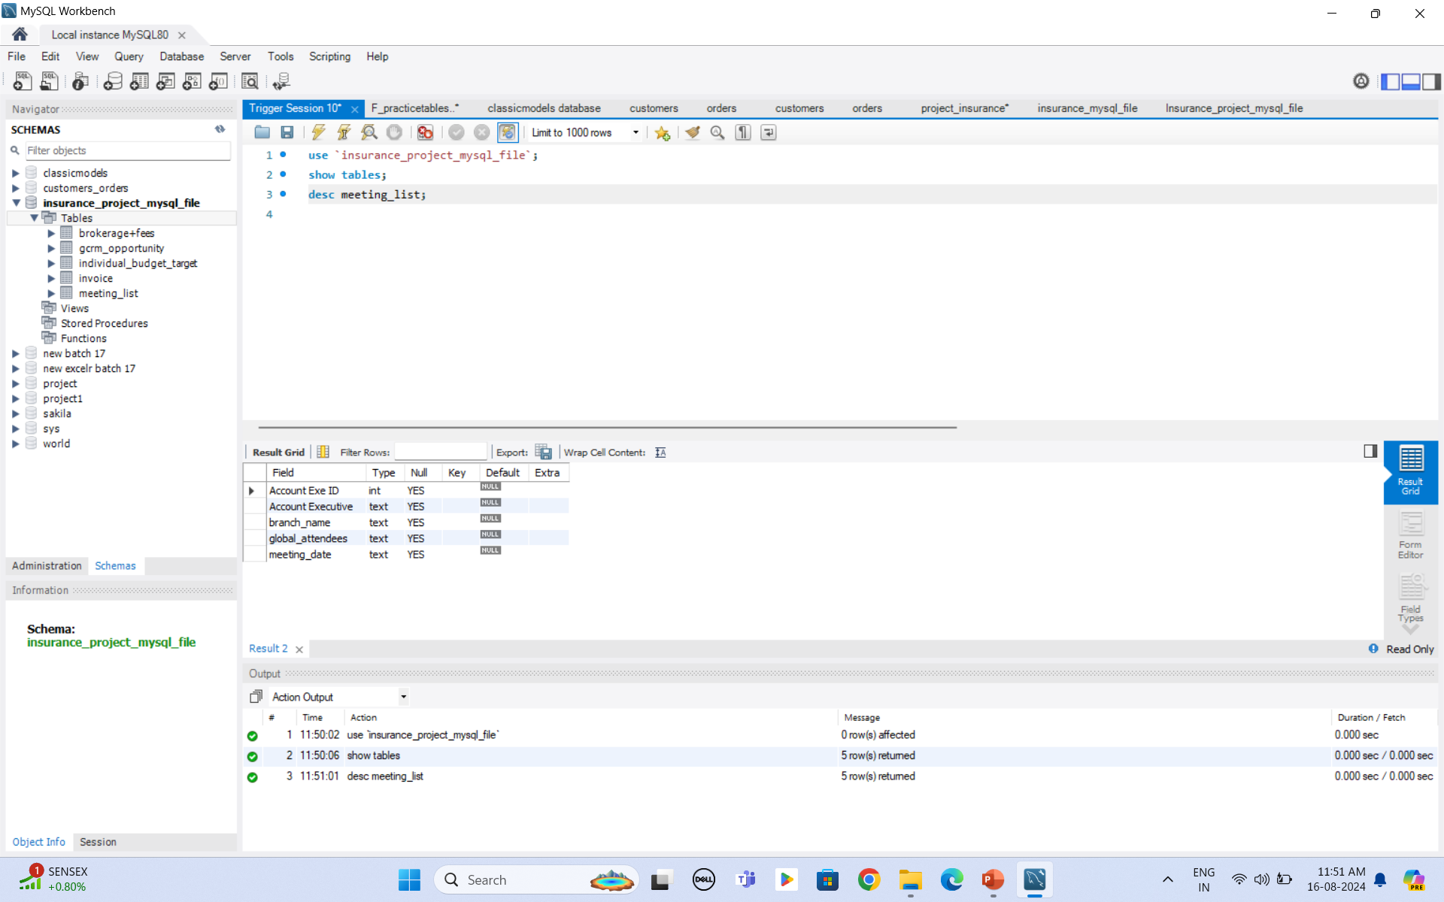
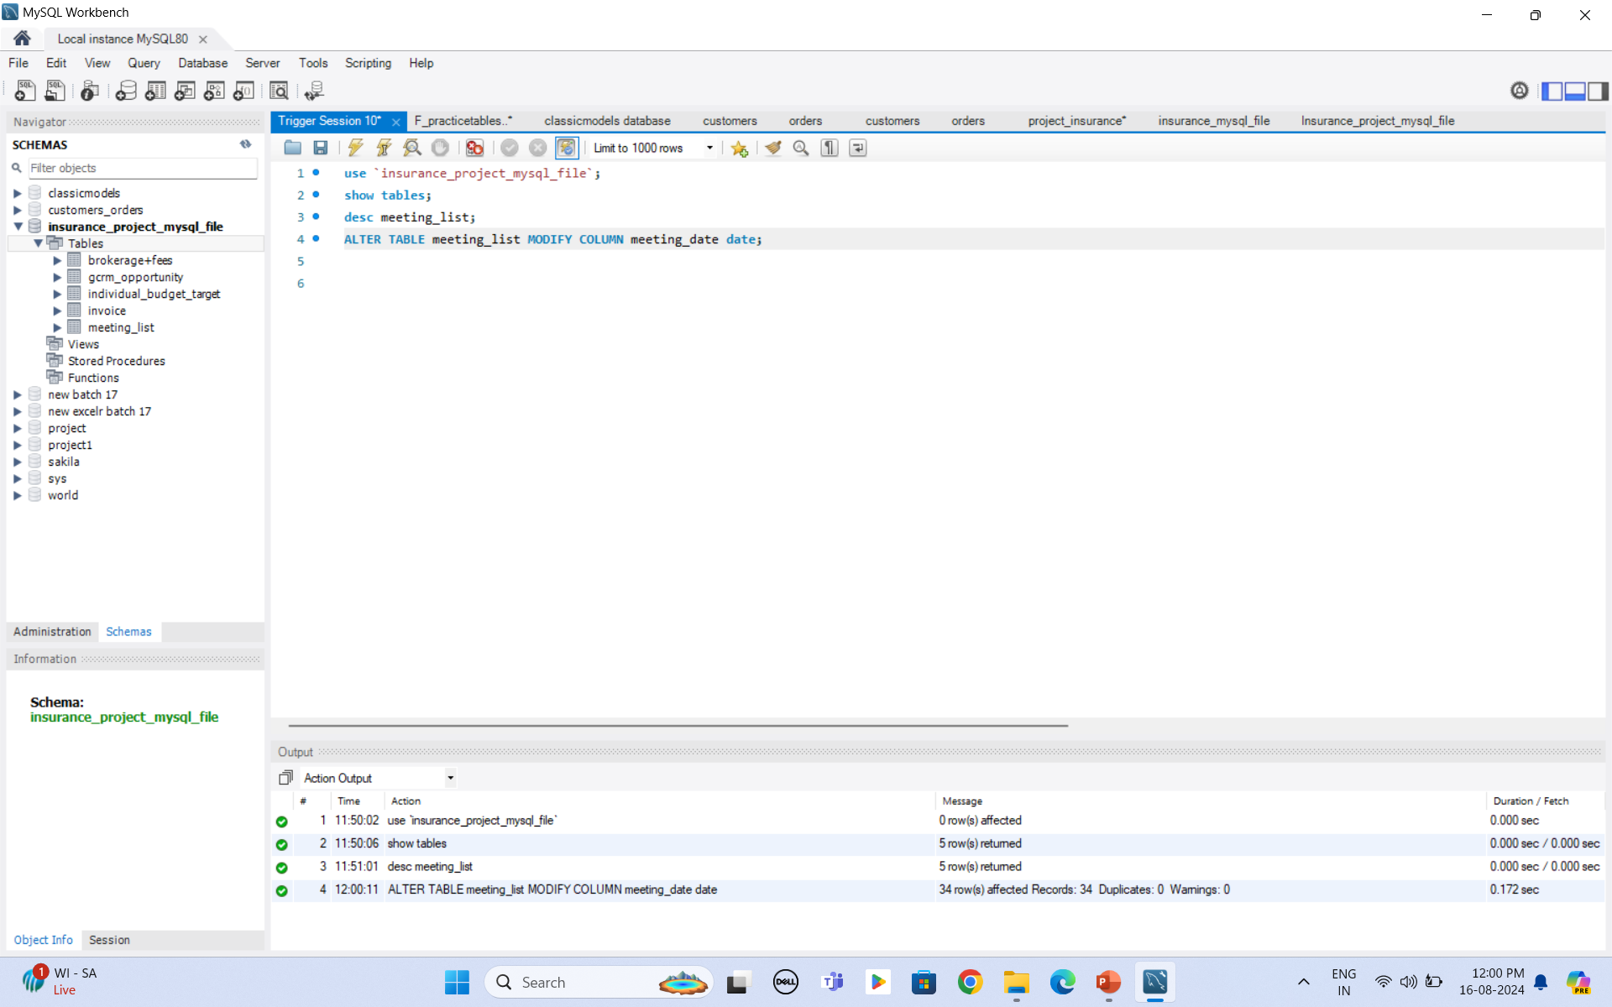
Excel Dashboard

Slide 7

MY SQL
Step 1:
Create a new database and import the Excel CSV file into the workbench.
Step 2:
Changed the data types of the columns where needed.

Slide 8
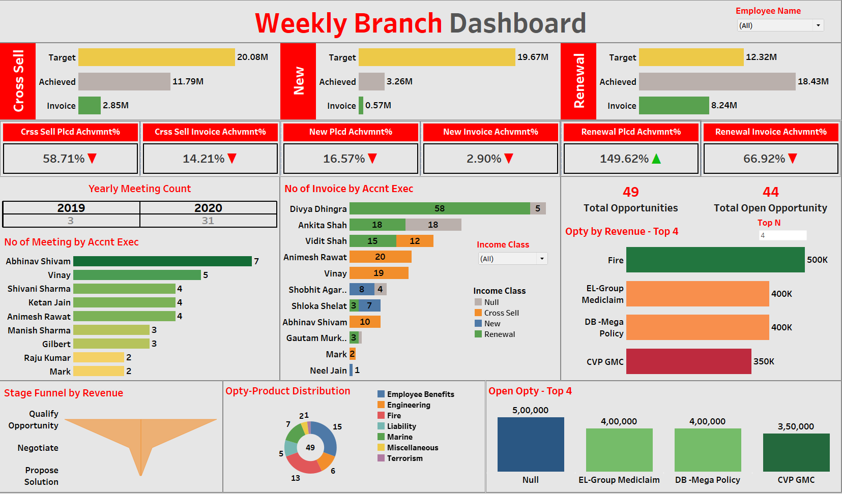
Steps to Import Data in Workbench
Step 1: Convert the Excel file into the CSV format
Step 2: Create a new database in MySQL Workbench.
Step 3: Import the CSV file into the database by following these steps:
Click on the dropdown of the newly created database.
Right-click on the "Tables" section.
Select "Table Data Import Wizard."
Choose the CSV file, then click "Next" to continue.
Step 4: Repeat the process to import the remaining files.

Slide 9
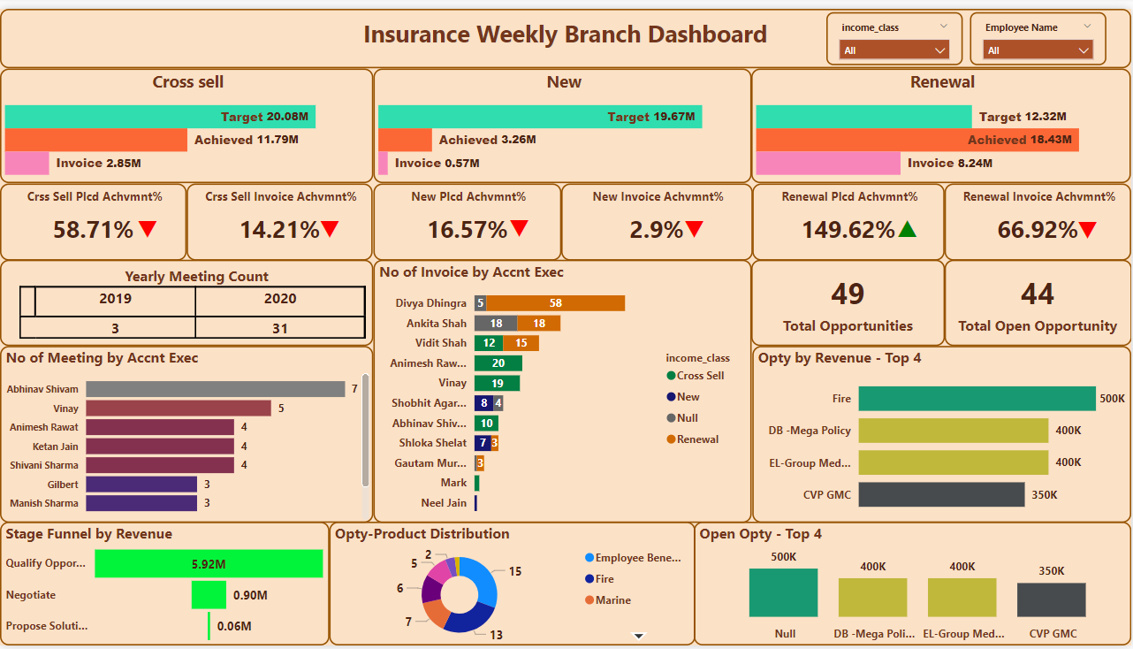
Tableau Dashboard

Slide 10

Power BI Dashboard

Slide 11



RECOMMENDATIONS
Continuous Monitoring
Regularly update the dashboard to reflect current data and trends.
Opportunity Management
Employee Development
Focus on converting open opportunities, especially in high-revenue categories, to meet and exceed sales targets.
Utilize the performance insights to provide targeted training and support for account executives.

Slide 12






Challenges
Data Cleaning
Prepare data by removing duplicates, handling missing values, correcting errors, and standardizing formats.
Create New Columns
Merge datasets on common keys to fill missing data or create new columns based on additional information.
Changing Data Types
Changing Data Types: Convert columns to appropriate data types to ensure correct data processing and analysis.

Slide 13

CONCLUSION
The Weekly Branch Dashboard serves as a vital tool for monitoring the insurance branch’s performance, identifying areas for improvement, and recognizing top-performing account executives. By visualizing key metrics, the dashboard enables strategic decision-making, fostering growth, and ensuring alignment with business targets.

Slide 14

THANK
YOU

